Slide 1

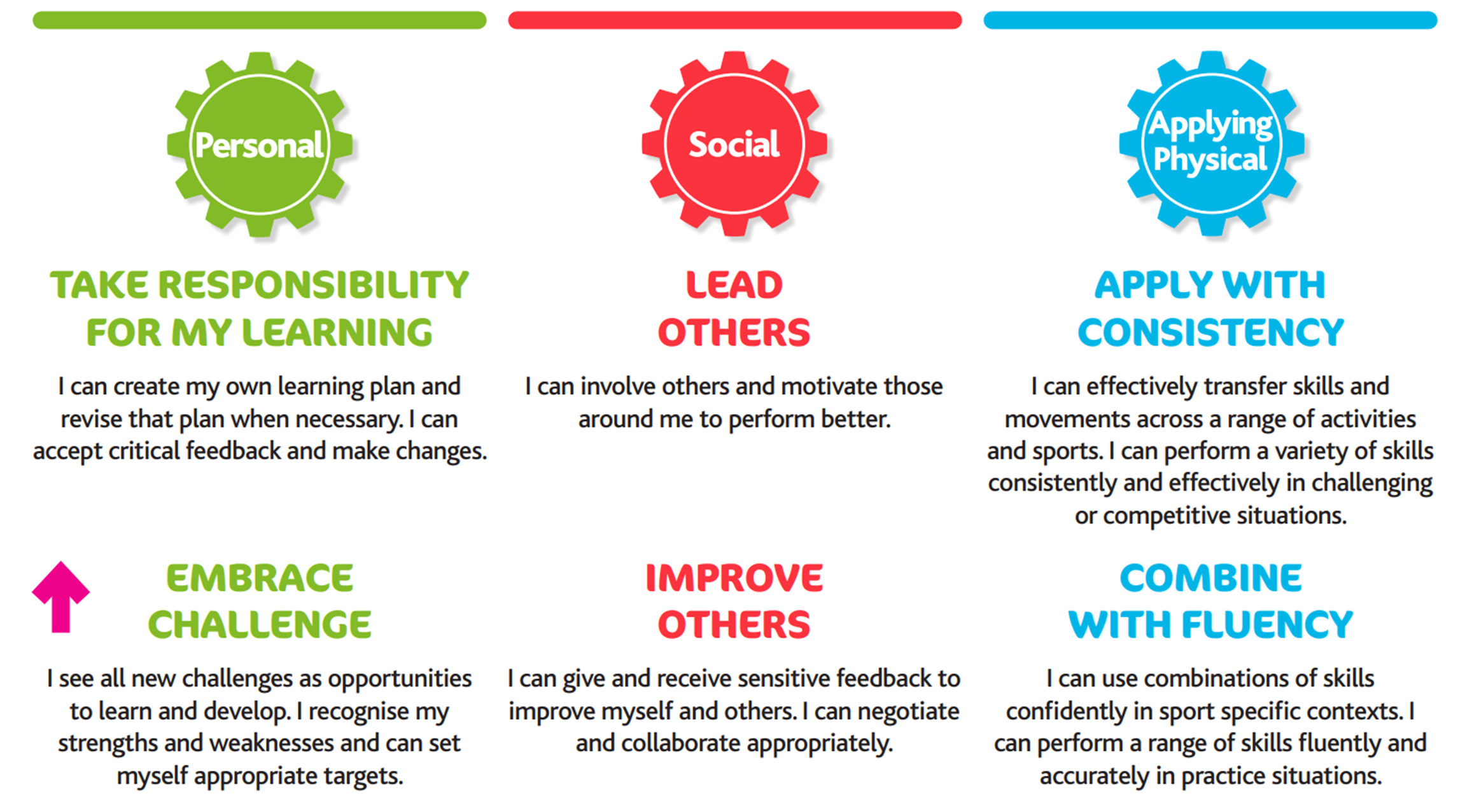
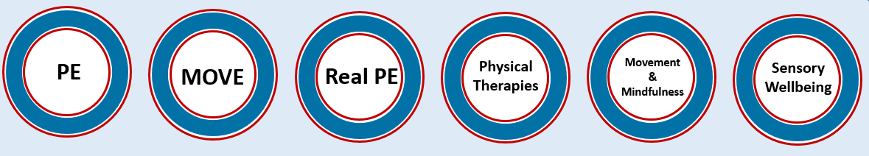
Nancealverne Physical Development Curriculum Offer
At Nancealverne School, Physical Development is fundamental to the health and wellbeing of our pupils. We provide our pupils with the tools and understanding required to make a positive impact on their own physical health and well-being. Pupils learn how to make decisions in response to creative, competitive and challenging activities. We have an inclusive curriculum that ensures all pupils have access to engaging and motivating physical and therapeutic activities, both in school and in their local communities. We develop pupil’s physical literacy whilst enhancing their enjoyment and knowledge of the subject. We teach pupils how to cooperate and collaborate with others and understand fairness and equality. We instil a culture of healthy, active life-styles, with the vision that our pupils will continue to adopt this into adulthood.
Intent
Physical Development encompasses 6 areas of enrichment at Nancealverne:
With these core areas integrated into our curriculum at all key stages, we provide a fully inclusive Physical Development program to meet the needs of our pupils. Through the identification of need in every pupil’s Education Health and Care Plan, each receive a bespoke PD curriculum offer, tailored to their ability, interests and aspirations.
Our pupils take part in a range of sports and physical activities within a supportive environment. They are encouraged to participate in exercise throughout the day, during PE lessons, clubs, outdoor learning, physical therapies and special events, on and off site.
Our pupils gain experience in a variety of fundamental skills including flexibility, strength, technique, control, agility, co-ordination and balance. Pupils take part in individual skills, group skills and team games, using PE equipment appropriate for their age.
We teach the National Curriculum, supported by a clear skills and knowledge progression, using the ‘Real PE’ program. This ensures that skills and subject knowledge are built upon and sequenced appropriately, to maximise learning for all pupils.
Implementation
Our pupils have a positive and engaged attitude towards physical activity. They are motivated to make informed positive choices, affecting their own physical health and wellbeing. Pupils meet their EHCP targets in Physical development and wider communication and social skills. Pupils leave school prepared for living healthy and active lives.
Impact

Slide 2
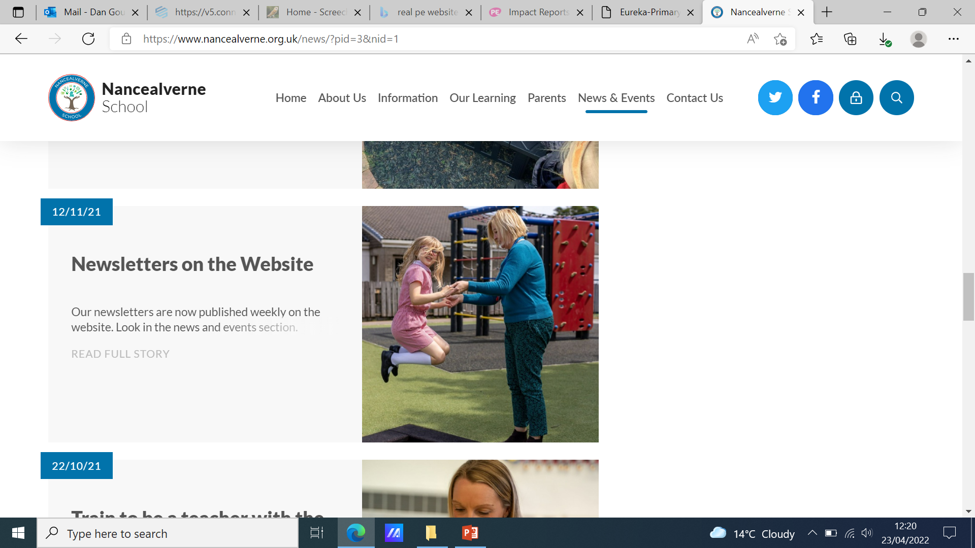
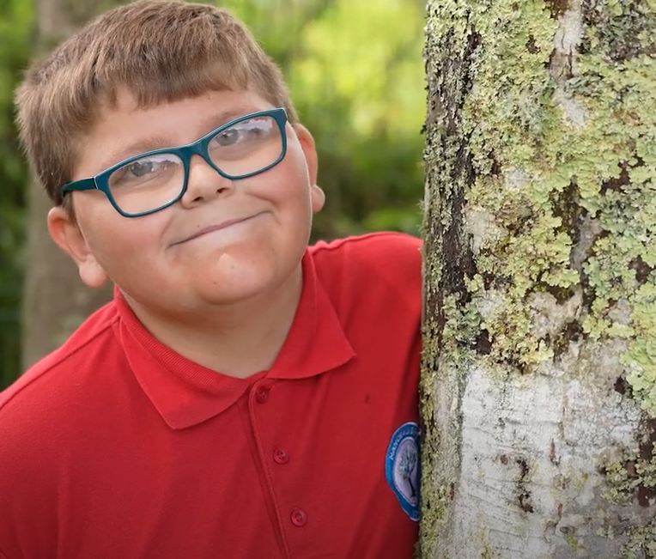
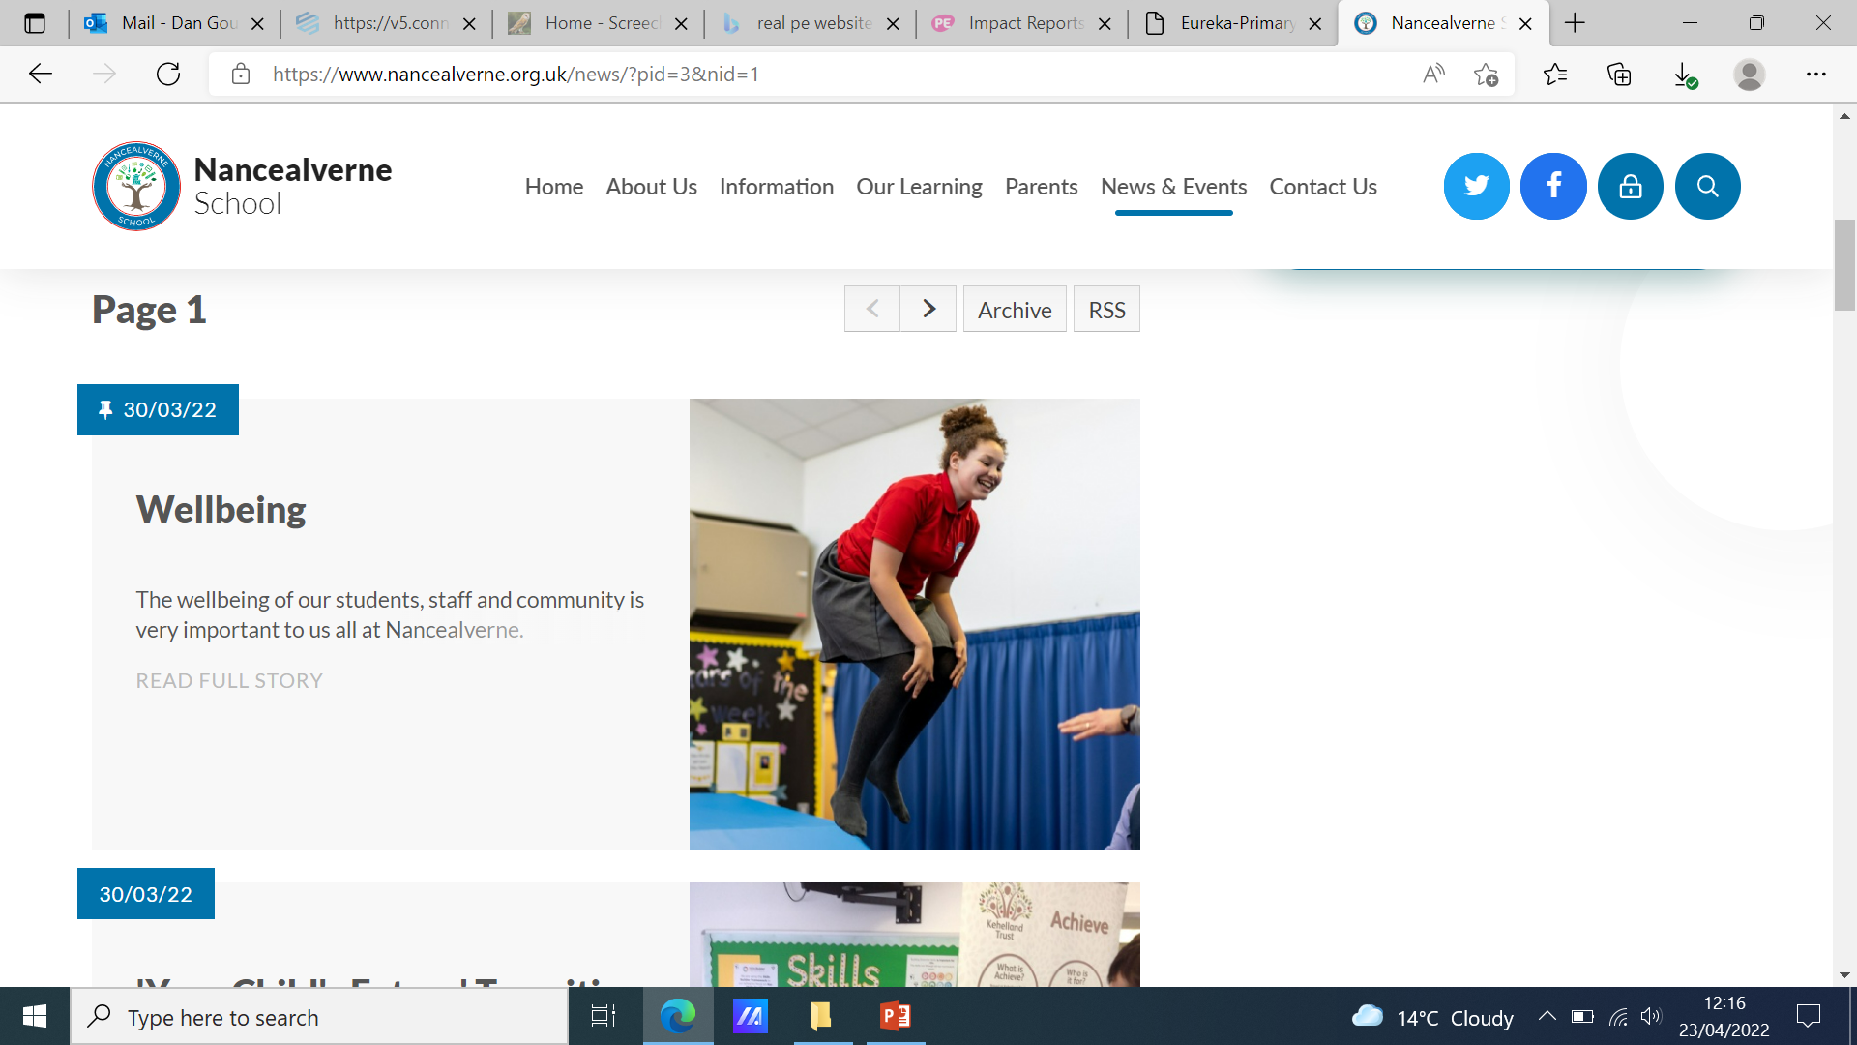
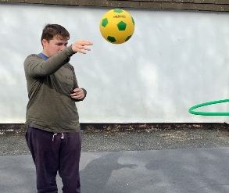
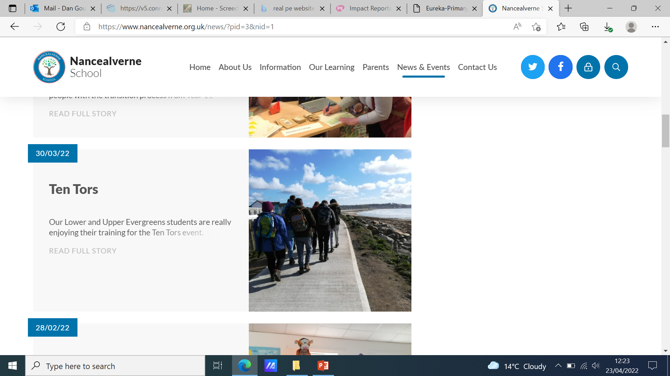
Nancealverne Physical Development Vision
Vision
Builds
upon experiences and opportunities to actively engage and connect with the world around us.
Develops
an independent knowledge and understanding of our own health and wellbeing.
Enriches physical, social and emotional development.
Instils
physical activity as a key part of a healthy happy lifestyle.
Inspires
healthy future lives, education and career aspirations.
At Nancealverne we offer opportunities to engage and connect through interactive and exciting experiences in our school, community and beyond.
At Nancealverne we offer an inclusive and differentiated Physical Development curriculum that builds on the individual learner’s own abilities and experiences.
At Nancealverne, social engagement and physical activity are central in our approach for teaching and learning in PD. Real PE and MOVE strategies are used within individual and team activities, ensuring a strong foundation of physical and social skills that can be applied across the curriculum.
At Nancealverne we instil a sense of self belief and independence to confidently take on new challenges and situations. We instil care and leadership skills as learners recognise how they can support their peers and community alike.
At Nancealverne we provide a broad range of independence skills and healthy living experiences to support future aspirations and opportunities in the wider world. Pupils can explore bespoke pathways options, whether as part of future college courses, community support settings, apprenticeships, or local roles and positions in the community.
PD/PE at our school

Slide 3
Implementation/Delivery - PD Curriculum
EYFS
L2L/ B2L KS 1 – KS4
R2L KS 1 – KS 3
R2L Key Stage 4
curriculum
Post 16
Within our EYFS provision PE learning is delivered via the Real PE units, in order to fulfil the EYFS areas of:
Knowledge & Understanding of the world
Personal, social & emotional development
Communication & Language
The delivery of PE will focus upon promoting pupil engagement, interest and early skill development which encourages them to:
Engage with other people and their environment.
Develop their skills within communication, playing and exploring
Develop and learn from relationships/ friendships
Build their curiosity (child initiated learning) and enthusiasm for learning
Begin to think critically to engage creatively
The PE curriculum will be taught and delivered through the Real PE units in conjunction with personalised learning outcomes (ILP/PLG’s).
Real PE unit areas are used to provide a supporting framework for learning outcomes.
The unit areas are then broken down into learning statements and level descriptors, providing developmental steps, appropriate to the needs and abilities of the pupils.
B₂ observational frameworks and baselining are used to assess pupil progress and development. Through such development, we can build upon pupils’ current skills, developing their knowledge and understanding to ensure learning becomes embedded.
Personalised pupil learning pathways are identified (PLG’s). Those identified as working within the R2L pathway will work more formally within subject specific learning, which sequences the teaching delivery to develop pupils’ PE skills through the breadth of study offered using the Real PE unitised framework.
Real PE unit areas are used to provide a supporting framework for learning outcomes:
Pupils will experience a range of physical activities/sports delivered in structured, sequentially planned sessions featured within class timetables.
Pupils will be provided with opportunities to access on-site and off-site sporting activities lead by specialist coaches.
R2L Key Stage 4 Curriculum/ long term planning offer building on learning achieved within KS3.
Within Post 16 the teaching delivery is focused around the Health, Wellbeing & Relationships strand of the curriculum through the Keeping Healthy for Life units of study.
Assessment is through our bespoke criteria for the Post 16 curriculum.
Accreditation opportunities continue through ASDAN Personal Progress units linked to the Health, Wellbeing and Relationships curriculum strand.
Pupils will also be provided with opportunities to access on-site and off-site sporting activities lead by specialist coaches.
Unit 1: Personal
Coordination: Footwork
Static Balance: One leg
Unit 2: Social
Dynamic Balance to Agility:
Jumping and landing
Static Balance: Seated
Unit 3: Cognitive
Dynamic Balance: On a Line
Static Balance: Stance
Unit 4: Creative
Coordination: Ball Skills
Counter Balance: With a Partner
Unit 5: Applying Physical
Coordination: Sending and Receiving
Agility: Reaction/Response
Unit 6: Health and Fitness
Agility: Ball Chasing
Static Balance: Floor Work
Development of engagement skills / working with therapy teams to support and promote fundamental movement skills and independent movements.
Development of PE skills within the breadth of offer delivered via a key skills and knowledge-based approach; accreditation opportunities identified where these hold value/ purpose to the pupil
Development of healthy and active lifestyles, on and off school site. Preparing for adulthood EHCP outcomes Yr10/11
Further development of a healthy and active lifestyle in preparing pupils for adult life
Development of fundamental movement skills within the breadth of the EYFS offer

Slide 4
PD Curriculum – Delivery – Real PE Unit Breakdown
Real PE Unit Areas
L2L – EYFS-KS4
(EYFS Real PE)
B2L – KS1-KS4
(Year 1 Real PE)
R2L – KS1-KS4
(Year 2 Real PE)
R2L – KS4/Post 16
(Year 3 Real PE)
Unit 1: Personal
Coordination: Footwork
Static Balance: One leg
Unit 2: Social
Dynamic Balance to Agility: Jumping and landing
Static Balance: Seated
Unit 3: Cognitive
Dynamic Balance: On a Line
Static Balance: Stance
Unit 4: Creative
Coordination: Ball Skills
Counter Balance: With a Partner
Unit 5: Applying Physical
Coordination: Sending and Receiving
Agility: Reaction/Response
Unit 6: Health and Fitness
Agility: Ball Chasing
Static Balance: Floor Work
Unit 1: Personal
I can follow instructions, practise safely and work on simple tasks by myself. I enjoy working on simple tasks with help.
Unit 2: Social
I can work sensibly with others, taking turns and sharing. I can play with others and take turns and share with help.
Unit 3: Cognitive
I can understand and follow simple rules and can name some things I am good at. I can follow simple instructions.
Unit 4: Creative
I can explore and describe different movements. I can observe and copy others.
Unit 5: Applying Physical
I can perform a single skill or movement with some control. I can perform a small range of skills and link two movements together
Unit 6: Health and Fitness
I can move confidently in different ways.
Unit 1: Personal
I try several times if at first I don’t succeed and I ask for help when appropriate. I can follow instructions, practise safely and work on simple tasks by myself. I enjoy working on simple tasks with help.
Unit 2: Social
I can help praise and encourage others in their learning. I can work sensibly with others, taking turns and sharing. I can play with others and take turns and share with help.
Unit 3: Cognitive
I can begin to order instructions, movements and skills. With help I can recognise similarities and differences in performance and I can explain why someone is working or performing well. I can understand and follow simple rules and can name some things I am good at. I can follow simple instructions.
Unit 4: Creative
I can begin to compare my movements and skills with those of others.
Unit 1: Personal
I know where I am with my learning and I have begun to challenge myself. I try several times if at first I don’t succeed and I ask for help when appropriate n l I can follow instructions, practise safely and work on simple tasks by myself
Unit 2: Social
I show patience and support others, listening well to them about our work. I am happy to show and tell them about my ideas. I can help praise and encourage others in their learning. I can work sensibly with others, taking turns and sharing
Unit 3: Cognitive
I can understand the simple tactics of attacking and defending. I can explain what I am doing well and I have begun to identify areas for improvement. I can begin to order instructions, movements and skills. With help I can recognise similarities and differences in performance and I can explain why someone is working or performing well.
Unit 1: Personal
I cope well and react positively when things become difficult. I can persevere with a task and I can improve my performance through regular practice. I know where I am with my learning and I have begun to challenge myself. I try several times if at first I don’t succeed and I ask for help when appropriate.
Unit 2: Social
I cooperate well with others and give helpful feedback. I help organise roles and responsibilities and I can guide a small group through a task. I show patience and support others, listening well to them about our work. I am happy to show and tell them about my ideas. I can help praise and encourage others in their learning.
Unit 3: Cognitive
I can understand ways (criteria) to judge performance and I can identify specific parts to continue to work upon. I can use my awareness of space and others to make good decisions.

Slide 5
Continued
I can select and link movements together to fit a theme. I can explore and describe different movements. I can observe and copy others.
Unit 5: Applying Physical
I can perform a range of skills with some control and consistency. I can perform a sequence of movements with some changes in level, direction or speed. I can perform a single skill or movement with some control. I can perform a small range of skills and link two movements together. I can move confidently in different ways.
Unit 6: Health and Fitness
I can say how my body feels before, during and after exercise. I use equipment appropriately and move and land safely. I am aware of why exercise is important for good health. I am aware of the changes to the way I feel when I exercise.
I can understand and follow simple rules and can name some things I am good at.
Unit 4: Creative
I can make up my own rules and versions of activities. I can respond differently to a variety of tasks or music and I can recognise similarities and differences in movements and expression. I can begin to compare my movements and skills with those of others. I can select and link movements together to fit a theme. I can explore and describe different movements
Unit 5: Applying Physical
I can perform and repeat longer sequences with clear shapes and controlled movement. I can select and apply a range of skills with good control and consistency. I can perform a range of skills with some control and consistency. I can perform a sequence of movements with some changes in level, direction or speed. I can perform a single skill or movement with some control. I can perform a small range of skills and link two movements together.
I can understand the simple tactics of attacking and defending. I can explain what I am doing well and I have begun to identify areas for improvement. I can begin to order instructions, movements and skills. With help I can recognise similarities and differences in performance and I can explain why someone is working or performing well.
Unit 4: Creative
I can link actions and develop sequences of movements that express my own ideas. I can change tactics, rules or tasks to make activities more fun or challenging. I can make up my own rules and versions of activities. I can respond differently to a variety of tasks or music and I can recognise similarities and differences in movements and expression. I can begin to compare my movements and skills with those of others. I can select and link movements together to fit a theme.
Unit 5: Applying Physical
I can perform a variety of movements and skills with good body tension.
Real PE Unit Areas
Unit 1: Personal
Coordination: Footwork
Static Balance: One leg
Unit 2: Social
Dynamic Balance to Agility: Jumping and landing
Static Balance: Seated
Unit 3: Cognitive
Dynamic Balance: On a Line
Static Balance: Stance
Unit 4: Creative
Coordination: Ball Skills
Counter Balance: With a Partner
Unit 5: Applying Physical
Coordination: Sending and Receiving
Agility: Reaction/Response
Unit 6: Health and Fitness
Agility: Ball Chasing
Static Balance: Floor Work

Slide 6
Continued
Unit 6: Health and Fitness
I can describe how and why my body feels during and after exercise. I can explain why we need to warm up and cool down. I can say how my body feels before, during and after exercise. I use equipment appropriately and move and land safely. I am aware of why exercise is important for good health.
I can link actions together so that they flow in running, jumping and throwing activities. I can perform and repeat longer sequences with clear shapes and controlled movement. I can select and apply a range of skills with good control and consistency. I can perform a range of skills with some control and consistency. I can perform a sequence of movements with some changes in level, direction or speed.
Unit 6: Health and Fitness
I can describe the basic fitness components and explain how often and how long I should exercise to be healthy. I can record and monitor how hard I am working. I can describe how and why my body feels during and after exercise. I can explain why we need to warm up and cool down. I can say how my body feels before, during and after exercise. I use equipment appropriately and move and land safely.
Real PE Unit Areas
Unit 1: Personal
Coordination: Footwork
Static Balance: One leg
Unit 2: Social
Dynamic Balance to Agility: Jumping and landing
Static Balance: Seated
Unit 3: Cognitive
Dynamic Balance: On a Line
Static Balance: Stance
Unit 4: Creative
Coordination: Ball Skills
Counter Balance: With a Partner
Unit 5: Applying Physical
Coordination: Sending and Receiving
Agility: Reaction/Response
Unit 6: Health and Fitness
Agility: Ball Chasing
Static Balance: Floor Work

Slide 7
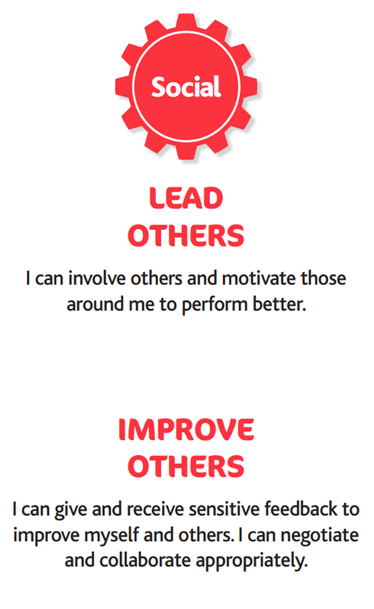
Nancealverne Physical Development – Real PE Vision

